Slide 1
GRANTS ACCOUNTING

Slide 2
GRANTS ACCOUNTING
REGINA HAILEY
GRANTS ACCOUNTANT MANAGER

Slide 3
ACCOUNTING APPLICATIONS
Grants Accounting Online Reporting Systems (GAORS)
Consolidated Application (Con AP)
Invoice Application
Completion Report Application

Slide 4
GAORS
Approved Grants
Federal 15 months of availability
Reimbursement request
DE147

Slide 5
CONSOLIDATED APPLICATION
State Board Approval of Grants
Allocation upload in Consolidated Application
Budget Process
Coordinator
Superintendent
Program Manager
Grants Accounting
Download into GAORS

Slide 6
CONSOLIDATED APPLICATION

Slide 7
INVOICE APPLICATION
Log into the portal.
Select Grants Application
Select Manage Invoices
Select the Fiscal Year
Select the appropriate grant
Select the fund month that you are processing and hit “ADD”

Slide 8
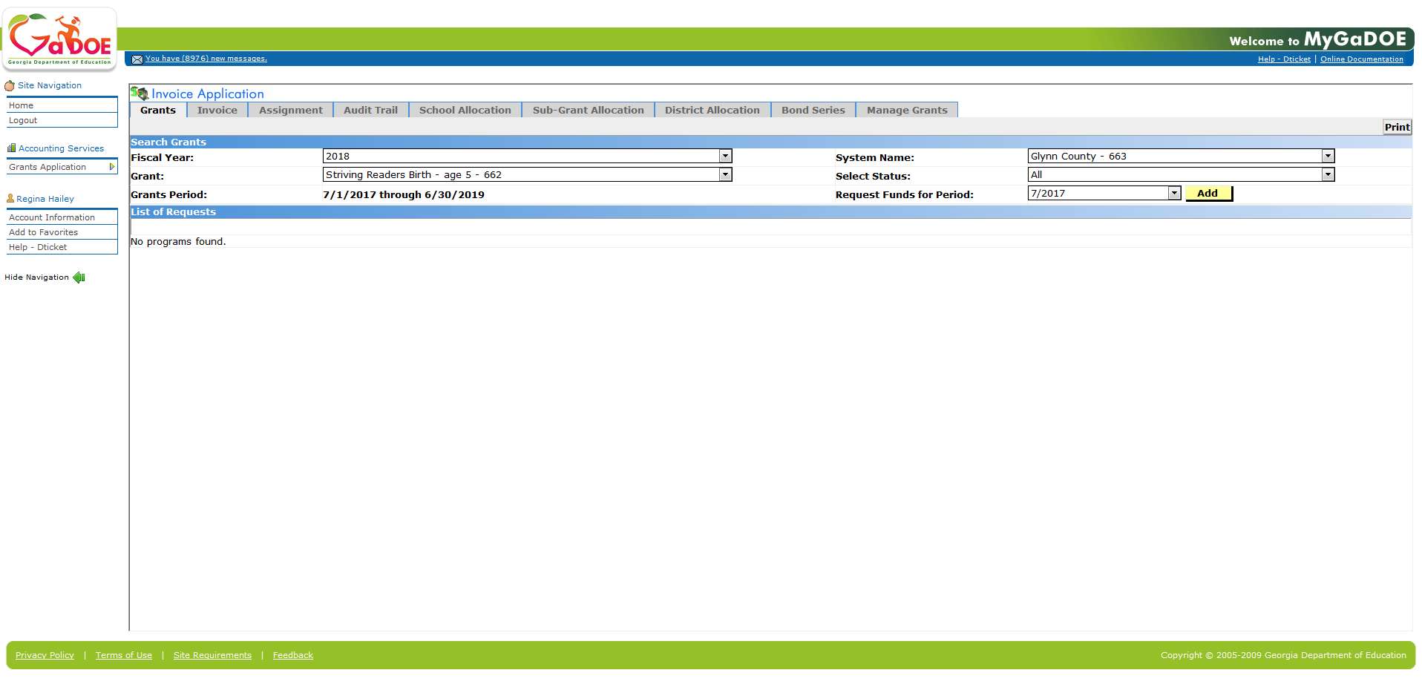
. INVOICE APPLICATION processing and hit

Slide 9
INVOICE APPLICATION ENTRY SCREEN

Slide 10
INVOICES BY SCHOOL

Slide 11
INVOICE APPLICATION FINAL STEPS
Once all invoices are updated, hit send to submitter
Then, go to submit invoices and pull up the request to verify. If ok, then hit submit
The request goes to the Program Manager for review
Once reviewed by Program Manager, then Grants Accounting approves and payment is submitted.

Slide 12
COMPLETION REPORT
LAST APPROVED BUDGET WILL BE LOADED IN COMPLETION REPORT
MUST USE FUNCTION/OBJECT CODES THAT ARE APPROVED BY PROGRAM
DO NOT CLOSE YOUR COMPLETION REPORT UNTIL ALL OF YOUR PAYMENTS HAVE BEEN REQUESTED/PAID BY THE SYSTEM
PROGRAM MANAGERS AND ACCOUNTING MUST COMMUNICATE $$$$$$$$

Slide 13
QUESTIONS

Slide 14
GRANTS ACCOUNTING TEAM
DELLA KILPATRICK – ACCOUNTING MANAGER (404-656-4668) dkilpatr@doe.k12.ga.us
REGINA HAILEY – GRANTS ACCOUNTANT MANAGER
(404-656-4676) rhailey@doe.k12.ga.us
KAMIKA MORRIS – GRANTS ACCOUNTANT
(404-656-5553) kmorris@doe.k12.ga.us

